Slide 1
Introduction
Dr. Vijay Kumar Chaurasiya
Associate Professor, IIIT Allahabad
Email: vijayk@iiita.ac.in

Slide 2
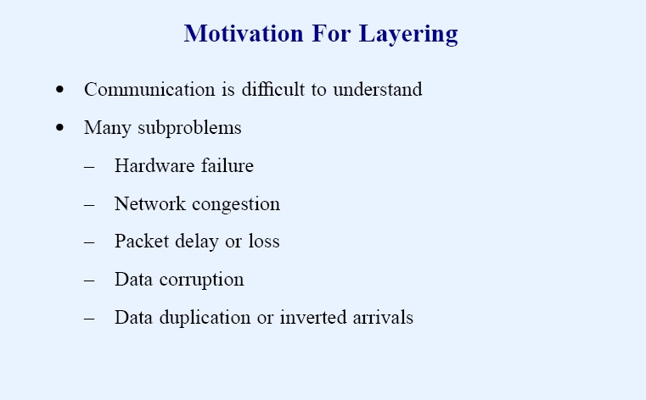

Slide 3
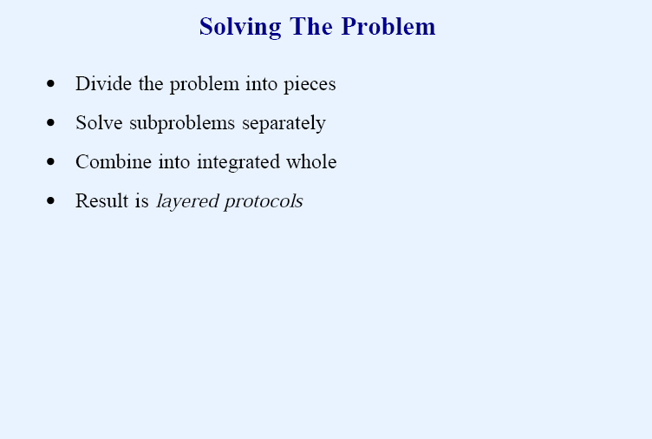

Slide 4
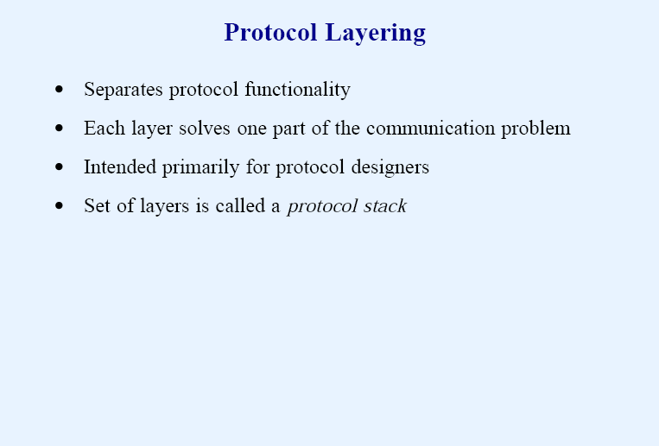

Slide 5
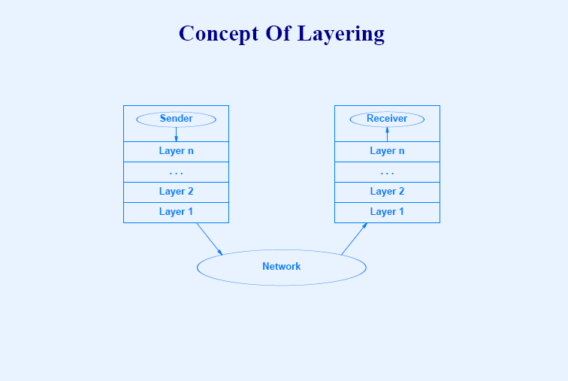

Slide 6
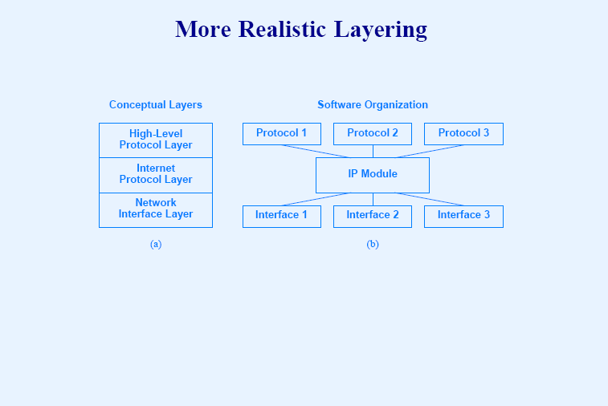

Slide 7
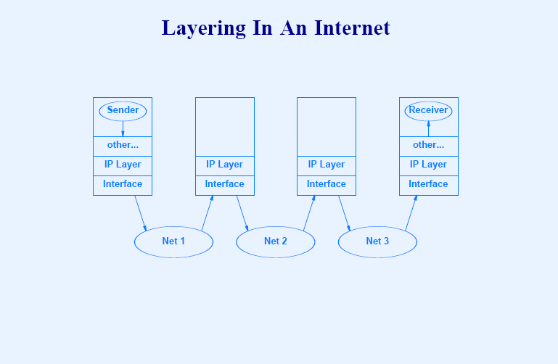

Slide 8
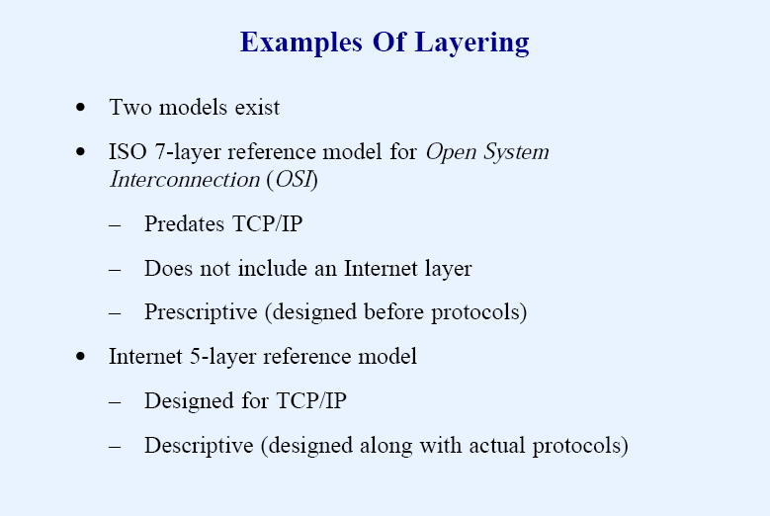

Slide 9
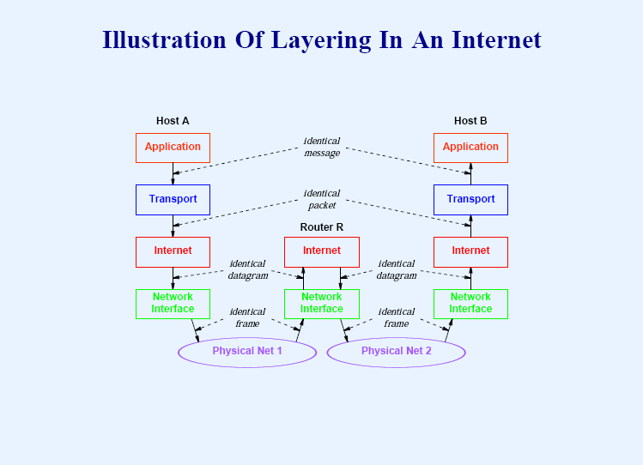

Slide 10
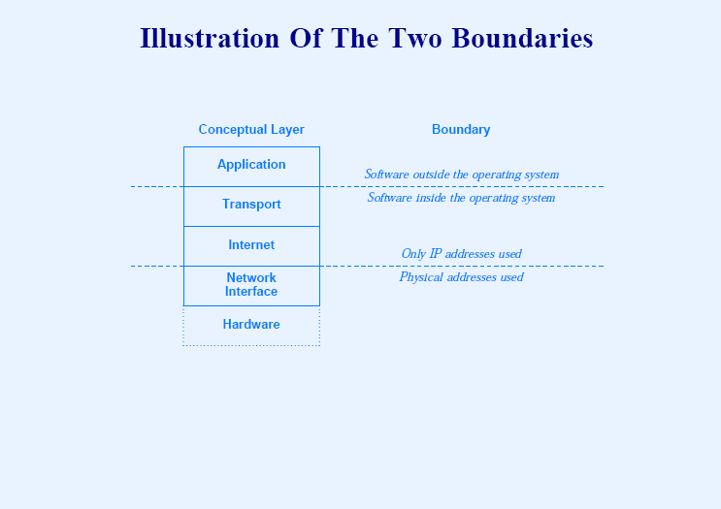

Slide 11
A 7- Layer ISO –OSI Model for Networking
Application Layer | High-level APIs, including resource sharing, remote file access.
Presentation Layer | Translation of data between a networking service and an application; including character encoding, data compression and encryption/decryption.
Session Layer | Managing communication sessions, i.e., continuous exchange of information in the form of multiple back-and-forth transmissions between two nodes.
Transport Layer | Reliable transmission of data segments between points on a network, including segmentation, acknowledgement and multiplexing
Network Layer | Structuring and managing a multi-node network, including addressing, routing and traffic control
Data Link Layer | Reliable transmission of data frames between two nodes connected by a physical layer
Physical Layer | Transmission and reception of raw bit streams over a physical medium
International Organization for Standardization (ISO) created the Open System Interconnection (OSI) protocol architecture starting in the late 1970s and matured by the early 1990s.

Slide 12
OSI Reference Model
OSI = Open Systems Interconnection: deals with open systems, i.e. systems open for communications with other systems.
Specified in ISO 7498.
Model has 7 layers.
Notes:
The OSI model describes the flow of data in a network, from the lowest layer (the physical connections) up to the layer containing the user’s applications. Data going to and from the network is passed layer to layer. Each layer is able to communicate with the layer immediately above it and the layer immediately below it. This way, each layer is written as an efficient, streamlined software component. When a layer receives a packet of information, it checks the destination address, and if its own address is not there, it passes the packet to the next layer.
When two computers communicate on a network, the software at each layer on one computer assumes it is communicating with the same layer on the other computer. For example, the Transport layer of one computer communicates with the Transport layer on the other computer. The Transport layer on the first computer has no regard for how the communication actually passes through the lower layers of the first computer, across the physical media, and then up through the lower layers of the second computer.

Slide 13
7-Layer OSI Model
Layer 7
Application Layer
Layers 1-3 are relate to communications technology.
Layers 4-7 are relate to user applications.
Layer 6
Presentation Layer
Layer 5
Session Layer
Layer 4
Transport Layer
Layer 3
Network Layer
Layer 2
Data Link Layer
Layer 1
Physical Layer
Communications subnet boundary
Notes:
The Application layer represents the level at which applications access network services. This layer represents the services that directly support applications such as software for file transfers, database access, and electronic mail.
• The Presentation layer translates data from the Application layer into an intermediary format. This layer also manages security issues by providing services such as data encryption, and compresses data so that fewer bits need to be transferred on the network.
• The Session layer allows two applications on different computers to establish, use, and end a session. This layer establishes dialog control between the two computers in a session, regulating which side transmits, plus when and how long it transmits.
• The Transport layer handles error recognition and recovery. It also repackages long messages when necessary into small packets for transmission and, at the receiving end, rebuilds packets into the original message. The receiving Transport layer also sends receipt acknowledgments.
• The Network layer addresses messages and translates logical addresses and names into physical addresses. It also determines the route from the source to the destination computer and manages traffic problems, such as switching, routing, and controlling the congestion of data packets.
• The Data Link layer packages raw bits from the Physical layer into frames (logical, structured packets for data). This layer is responsible for transferring frames from one computer to another, without errors. After sending a frame, it waits for an acknowledgment from the receiving computer.
• The Physical layer transmits bits from one computer to another and regulates the transmission of a stream of bits over a physical medium. This layer defines how the cable is attached to the network adapter and what transmission technique is used to send data over the cable
This partition into ‘lower’ and ‘upper’ layers is a widely used way to distinguish between the communications-oriented layers and the applications- oriented layers.
In fact layers 5 and 6 are often ignored in practical applications (the Internet protocol hierarchy has no equivalents to layers 5 and 6).

Slide 14
Layer 7: Application Layer
Level at which applications access network services.
Represents services API
directly support software applications for file transfers, database access, and electronic mail etc.
Protocols:
BOOTP: Bootstrap Protocol,
DCAP: Data Link Switching Client Access Protocol,
DHCP: Dynamic Host Configuration Protocol,
DNS: Domain Name System (Service) Protocol
Notes:
The Application Layer is home to a wide variety of protocols to meet specific user needs.
Network virtual terminal. Used by ‘networked screen editors’ and other networked applications needing to handle many different terminal types. Software exists to map the functions of the virtual terminal onto the real terminal, e.g. cursor movement. Examples include OSI VTP and Internet telnet.
File transfer. Different file systems have different file naming conventions and internal record structures. Such a protocol must convert files to a ‘standard’ representation. Examples include OSI FTAM and Internet ftp.
Electronic mail. Examples of electronic mail protocols are OSI X.400 and Internet mail.
Directory service. Examples include OSI X.500.

Slide 15
Application Layer Protocols
FTP: File Transfer Protocol
Finger: User Information Protocol
HTTP: Hypertext Transfer Protocol
S-HTTP: Secure Hypertext Transfer Protocol
IMAP & IMAP4: Internet Message Access Protocol
IRCP: Internet Relay Chat Protocol
LDAPv3: Lightweight Directory Access Protocol
MIME (S-MIME): Multipurpose Internet Mail Extensions and Secure MIME
NAT: Network Address Translation
NNTP: Network News Transfer Protocol

Slide 16
Application Layer Protocols
SMTP: Simple Mail Transfer Protocol
SNMP: Simple Network Management Protocol
SNMPv1: Simple Network Management Protocol version one
SNMPv2: Simple Network Management Protocol version two
SNMPv3: Simple Network Management Protocol version three

Slide 17
Application Layer Protocols
NTP: Network Time Protocol
POP and POP3: Post Office Protocol (version 3)
Rlogin: Remote Login in UNIX Systems
SNTP: Simple Network Time Protocol
TELNET: Terminal Emulation Protocol of TCP/IP
FTP: File Transfer Protocol
TFTP: Trivial File Transfer Protocol
URL: Uniform Resource Locator
Whois (and RWhois): Remote Directory Access Protocol

Slide 18
Layer 6: Presentation Layer
Related to representation of transmitted data
Translates different data representations from the Application layer into uniform standard format
Providing services for secure efficient data transmission
e.g. data encryption, and data compression.
Protocols:
Abstract Syntax Notation One (ASN.1), with capabilities such as converting an EBCDIC-coded text file to an ASCII-coded file. ASN.1 effectively makes an application protocol invariant with respect to syntax.
LPP: Lightweight Presentation Protocol
Notes:
The Presentation Layer is concerned with the representation of data to be transmitted, e.g. providing a standard encoding for data.
Different computers often use different representations for data structures such as characters (ASCII or EBCDIC), integers (one’s complement or two’s complement, and varying byte ordering conventions), and floating point values (IEEE or proprietary).
The Presentation Layer provides a standard encoding technique (using ASN.1 - Abstract Syntax Notation 1).
The Presentation Layer is also concerned with other representation issues such as data compression and encryption of data.
In terms of the usual communications model, the Presentation Layer is responsible for source coding of data.

Slide 19
Layer 5: Session Layer
Allows two applications on different computers to establish, use, and end a session.
e.g. file transfer, remote login
Establishes dialog control
Regulates which side transmits, plus when and how long it transmits.
Performs token management and synchronization.
Protocols:
RPC: Remote Procedure Call Protocol
Notes:
The Session Layer allows the establishment of sessions between machines, e.g. to allow remote logins to a multi-user system, or to perform file transfer between machines.
One of the Session services is dialogue control; if the communications are half-duplex then the session layer can manage which entity sends when.
A related service is token management. In some protocols it is essential that both entities do not attempt the same operation simultaneously. Possession of a token permits the operation.
The other main Session service is synchronization. As an example consider attempting a 2-hour file transfer between machines which crash on average once an hour. The synchronization service provides a means for checkpoints to be inserted into the data stream so that, after a crash, only data sent since the last checkpoint needs to be re-transmitted.

Slide 20
Layer 4: Transport Layer
Manages transmission packets
Repackages long messages when necessary into small packets for transmission
Reassembles packets in correct order to get the original message.
Handles error recognition and recovery.
Transport layer at receiving acknowledges packet delivery.
Resends missing packets
Provides Connection less and Connection Oriented data delivery services
Provide port number to identify sockets of the connection
Notes:
The basic function of the Transport Layer is to take data from the Session Layer (Layer 5), split it up into smaller units (as necessary), and pass these units on to the Network Layer. It is then also responsible for ensuring that all the pieces are received correctly and reassembled in the correct order.
Typically the Transport Layer will create a distinct Network Layer connection for each Transport connection requested by the Session Layer. However, depending on the data load and the capacity of a single Session channel:
multiple Network connections might be used to support a single high-bandwidth Session connection, or
one high-bandwidth Network connection might be used to support several Session connections.
The Transport Layer also determines what Type of Service to provide to the Session Layer and, ultimately, to the network users. For example:
an error-free, point-to-point channel, guaranteeing data is delivered in the correct order (the most common type of service),
transport of isolated messages with no guarantee of correct ordering, or
message broadcast to multiple destinations
Transport is the first true end-to-end layer, i.e. the Transport protocol communicates between end parties and not to any of the intermediaries.

Slide 21
Layer 4: Transport Layer
Protocols
TCP: Transmission Control Protocol
UDP: User Datagram Protocol
RDP: Reliable Data Protocol
RUDP: Reliable User Datagram Protocol (Reliable UDP)
Notes:
The basic function of the Transport Layer is to take data from the Session Layer (Layer 5), split it up into smaller units (as necessary), and pass these units on to the Network Layer. It is then also responsible for ensuring that all the pieces are received correctly and reassembled in the correct order.
Typically the Transport Layer will create a distinct Network Layer connection for each Transport connection requested by the Session Layer. However, depending on the data load and the capacity of a single Session channel:
multiple Network connections might be used to support a single high-bandwidth Session connection, or
one high-bandwidth Network connection might be used to support several Session connections.
The Transport Layer also determines what Type of Service to provide to the Session Layer and, ultimately, to the network users. For example:
an error-free, point-to-point channel, guaranteeing data is delivered in the correct order (the most common type of service),
transport of isolated messages with no guarantee of correct ordering, or
message broadcast to multiple destinations
Transport is the first true end-to-end layer, i.e. the Transport protocol communicates between end parties and not to any of the intermediaries.

Slide 22
Layer 3: Network Layer
Manages addressing/routing of data within the subnet
Addresses messages and translates logical addresses and names into physical addresses.
Determines the route from the source to the destination computer
Manages traffic problems, such as switching, routing, and controlling the congestion of data packets.
Routing can be:
Based on static tables
determined at start of each session
Individually determined for each packet, reflecting the current network load.
Notes:
The Network Layer controls the subnet.
The key design issue is routing of data within the subnet. Routing can be:
based on static tables (rarely changed),
determined at the start of each session, or
highly dynamic: individually determined for each packet, reflecting the current network load.
Too many packets in the subnet simultaneously can form bottlenecks; this is dealt with by congestion control procedures in the Network Layer.
Accounting for subnet use is also typically the responsibility of the Network Layer.
When a packet travels from one network to another, address conversion may be necessary; this is also performed by the Network Layer.
In Broadcast networks (e.g. many LANs), the routing problem is very straightforward, and hence Layer 3 will be very simple, or even non-existent.

Slide 23
Layer 3: Network Layer
Provides connectionless best effort data delivery services to upper layer protocols
Best effort data delivery services means:
Packets may follow different path to reach to the destination
Packet may be lost in the network
Packet may experience unexpected delay in reaching the destination
Packets may reach out of order at the destination
Protocols
IP: Internet Protocol (IPv4)
IPv6: Internet Protocol version 6
ICMP & ICMPv6: Internet Message Control Protocol and ICMP version 6
Mobile IP: IP Mobility Support Protocol for IPv4 & IPv6
IPSec: IP Security Protocol
Notes:
The Network Layer controls the subnet.
The key design issue is routing of data within the subnet. Routing can be:
based on static tables (rarely changed),
determined at the start of each session, or
highly dynamic: individually determined for each packet, reflecting the current network load.
Too many packets in the subnet simultaneously can form bottlenecks; this is dealt with by congestion control procedures in the Network Layer.
Accounting for subnet use is also typically the responsibility of the Network Layer.
When a packet travels from one network to another, address conversion may be necessary; this is also performed by the Network Layer.
In Broadcast networks (e.g. many LANs), the routing problem is very straightforward, and hence Layer 3 will be very simple, or even non-existent.

Slide 24
Layer 3: Network Layer
OSPF: Open Shortest Path First Protocol (version 2)
RIP: Routing Information Protocol (RIP2)
RIPng: Routing Information Protocol next generation for IPv6
RSVP: Resource Reservation Protocol
Notes:
The Network Layer controls the subnet.
The key design issue is routing of data within the subnet. Routing can be:
based on static tables (rarely changed),
determined at the start of each session, or
highly dynamic: individually determined for each packet, reflecting the current network load.
Too many packets in the subnet simultaneously can form bottlenecks; this is dealt with by congestion control procedures in the Network Layer.
Accounting for subnet use is also typically the responsibility of the Network Layer.
When a packet travels from one network to another, address conversion may be necessary; this is also performed by the Network Layer.
In Broadcast networks (e.g. many LANs), the routing problem is very straightforward, and hence Layer 3 will be very simple, or even non-existent.

Slide 25
Layer 2: Data Link Layer
Provides reliable transmission of frames on node to node basis
Provides frame abstraction (Framing Protocols)
Provides physical address to the nodes in the network
Provides Flow Control
It waits for an acknowledgment from the receiving computer.
Retransmits frames for which acknowledgement not received
Provides Error Control
Provides Medium Access Control
Notes:
This layer takes the ‘raw’ transmission facility provided by the Physical Layer (Layer 1) and uses it to provide a reliable, error-free transmission service.
It does this by breaking the data stream up into frames, typically of thousands of bytes in length. Where necessary, special acknowledgement frames can be sent back by the receiving Data Link entity to indicate successful receipt of each frame.
The Physical Layer transmits a continuous sequence of bits, and so Layer 2 must create and recognise frame boundaries. This is typically done by the insertion of special bit patterns.
Channel errors can completely destroy a frame, and hence retransmission may be necessary. This, in turn, leads to the possibility of duplicate frames being received. Data Link protocols must deal with these problems.
A Data Link protocol may offer several different ‘service classes’ to the Network Layer, each with a different quality and cost.
The Data Link Layer must also regulate traffic flow to prevent ‘swamping’ of a slow receiver.
In a duplex channel there may be competition between data and acknowledgment frames; one solution is known as piggybacking, where acknowledgement information is attached to data frames.

Slide 26
Layer 2: Data Link Layer
Protocols
ARP and InARP: Address Resolution Protocol and Inverse ARP.
RARP: Reverse Address Resolution Protocol
Stop and Wait Protocol
Sliding Window Protocol
PPP
DDCMP
IEEE 802.3 onwards
CRC, Checksum, Hamming Codes…
Notes:
This layer takes the ‘raw’ transmission facility provided by the Physical Layer (Layer 1) and uses it to provide a reliable, error-free transmission service.
It does this by breaking the data stream up into frames, typically of thousands of bytes in length. Where necessary, special acknowledgement frames can be sent back by the receiving Data Link entity to indicate successful receipt of each frame.
The Physical Layer transmits a continuous sequence of bits, and so Layer 2 must create and recognise frame boundaries. This is typically done by the insertion of special bit patterns.
Channel errors can completely destroy a frame, and hence retransmission may be necessary. This, in turn, leads to the possibility of duplicate frames being received. Data Link protocols must deal with these problems.
A Data Link protocol may offer several different ‘service classes’ to the Network Layer, each with a different quality and cost.
The Data Link Layer must also regulate traffic flow to prevent ‘swamping’ of a slow receiver.
In a duplex channel there may be competition between data and acknowledgment frames; one solution is known as piggybacking, where acknowledgement information is attached to data frames.

Slide 27
Layer 1: Physical Layer
Transmits bits from one computer to another
Regulates the transmission of a stream of bits over a medium Wired/Wireless.
Defines how the cable is attached to the network adapter and what transmission technique is used to send data over the cable. Deals with issues like
The definition of 0 and 1, e.g. how many volts represents a 1, and how long a bit lasts?
Whether the channel is simplex or duplex?
How many pins a connector has, and what the function of each pin is?
Notes:
The Physical Layer is concerned with the details of bit transmission over a physical channel.
Design issues for this layer include:
the definition of 0 and 1, e.g. how many volts represents a 1, and how long a bit lasts,
whether the channel is simplex or duplex,
how many pins a connector has, and what the function of each pin is.
More generally, design issues here deal with Mechanical, Electrical and Procedural matters.

Slide 28
Layer 1: Physical Layer
Protocols:
Encoding techniques
Modulation techniques
Interface Standards
Transmission media
Wired
Wireless
The physical layer is also concerned with:
Bit rate
Point-to-point, multipoint or point-to-multipoint line configuration
Physical network topology, for example bus, ring, mesh or star network
Serial or parallel communication
Simplex, half duplex or full duplex transmission mode
Notes:
The Physical Layer is concerned with the details of bit transmission over a physical channel.
Design issues for this layer include:
the definition of 0 and 1, e.g. how many volts represents a 1, and how long a bit lasts,
whether the channel is simplex or duplex,
how many pins a connector has, and what the function of each pin is.
More generally, design issues here deal with Mechanical, Electrical and Procedural matters.

Slide 29
TCP/IP vs OSI
Application
Application
Explicit Presentation and session layers missing in Internet Protocols
Data Link and Network Layers redesigned
Presentation
Session
Transport
TCP
Network
IP
Network Interface
Data Link
Physical
Hardware
Notes:
The Physical Layer is concerned with the details of bit transmission over a physical channel.
Design issues for this layer include:
the definition of 0 and 1, e.g. how many volts represents a 1, and how long a bit lasts,
whether the channel is simplex or duplex,
how many pins a connector has, and what the function of each pin is.
More generally, design issues here deal with Mechanical, Electrical and Procedural matters.

Slide 30
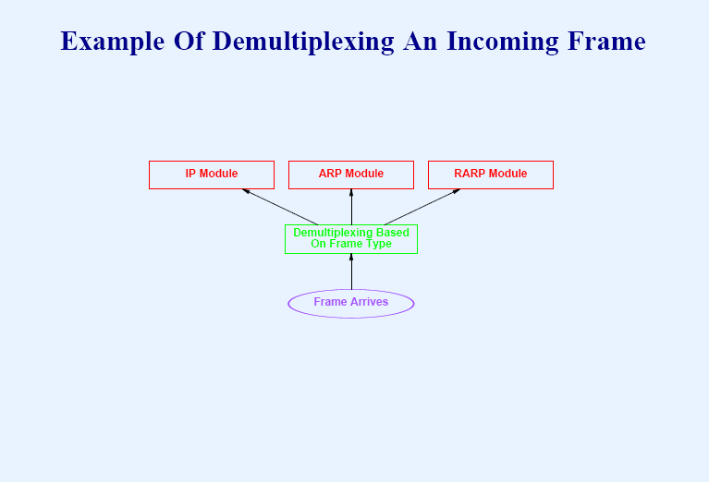

Slide 31
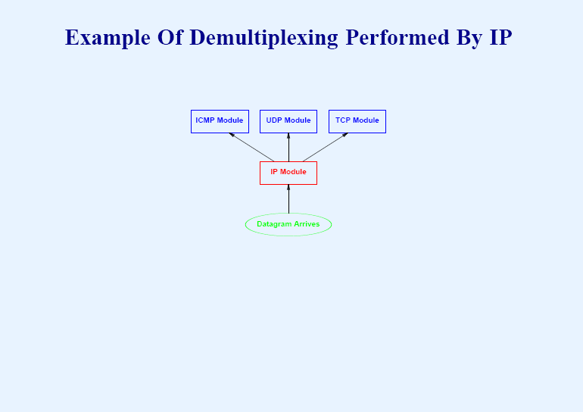

Slide 32
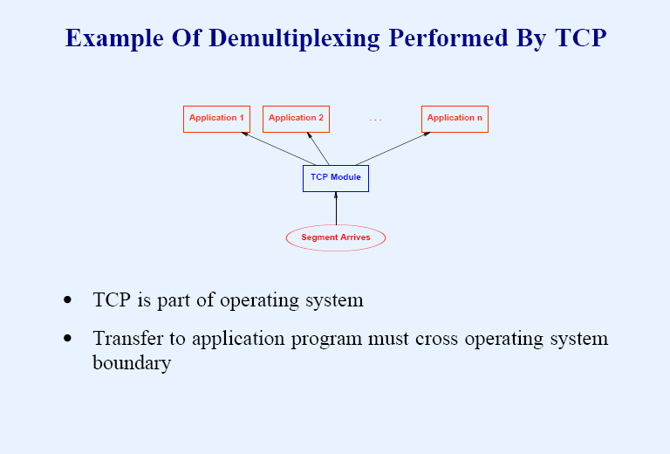

Slide 33
Connections
Layers can offer connection-oriented or connectionless services.
Connection-oriented like telephone system Circuit Switching.
Connectionless like postal system Packet Switching.
Each service has an associated Quality-of-service (e.g. reliable or unreliable).
Notes:
Most layers can offer two different types of service:
connection-oriented service, and
connectionless service.
Connection-oriented services are like the telephone system. There are three phases to a connection:
connection establishment (as in picking up the telephone and dialling),
data transfer (conversation), and
connection release (put down the telephone).
Connectionless services are like the postal system. Each message, like a letter, is equipped with the complete address of the recipient, and each message is routed independently. Re-ordering of messages may occur (unlike with a connection-oriented service).
Each service has an associated quality-of-service.

Slide 34
Reliability
Reliable services never lose/corrupt data.
Reliable service costs more.
Typical application for reliable service is file transfer.
Typical application not needing reliable service is voice traffic.
Notes:
Reliable services never lose or corrupt data; to implement a reliable service typically requires the receiver to acknowledge receipt of each part of a message. Hence providing a reliable service has an overhead, and so a choice needs to be made between cheapness and the level of reliability required.
A typical application of a reliable connection-oriented service is file transfer. A recipient of a file will want to be sure that it is correct, even though this may cost more.
Some applications do not need a reliable service, and indeed may not be able to cope with the delays associated with providing one. A simple example is provided by digitised voice traffic, where delay is less tolerable than the occasional burst of noise.

Slide 35
Protocols
Protocol = set of rules governing data communication between peer entities, i.e. format and meaning of frames/packets.
Service/protocol decoupling very important.
Notes:
Services and protocols are two quite distinct things, although they are often confused.
A service consists of a set of primitives (or operations) provided by one layer to the layer above it. The service defines what operations the layer can perform, but says nothing about how they are provided.
By contrast, a protocol is a set of rules governing what is actually transmitted between peer entities, i.e. the format and meaning of frames, packets or messages.
Entities use protocols to implement their service definitions, and are free to change their protocol provided the set of services does not change. That is services and protocols are decoupled.
Many pre-OSI protocols did not make this distinction, e.g. a typical layer might have a service primitive called send packet, referring to a pre-assembled packet of data. This causes great problems when individual protocols need to be replaced.

Slide 36
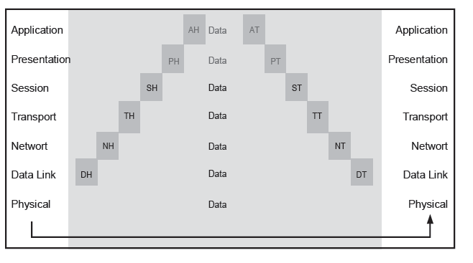
Header Encapsulation

Slide 37
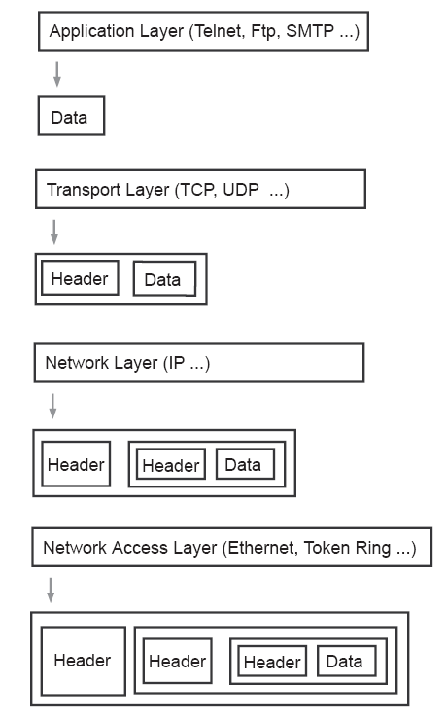

Slide 38
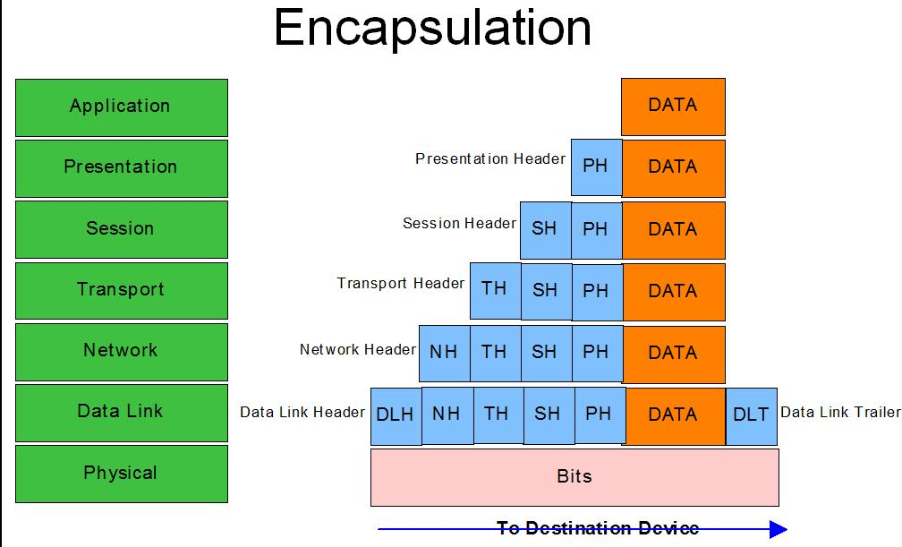
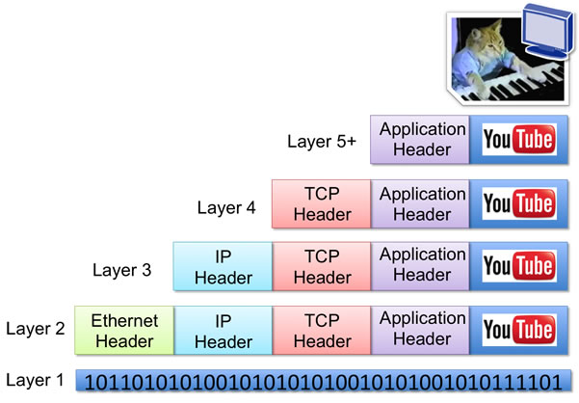

Slide 40
Other Protocols of Interest
VoIP (Voice over IP)
RTP (Real Time Transfer Protocol)
SIP (Session Initiation Protocol)
SSH (Secure Shell)
IGMP (Internet Group Management Protocol)
PPP (Point to Point Protocol)
SLIP (Serial Line Internet Protocol)

